Slide 1


LIGHT POLLUTION
LOGO
creative
2025
AND HOW IT AFFECTS THE NIGHT
DE:VLAD,MATI,STEFAN,DAVID

Slide 2

HOW LIGHT POLLUTION AFFECTS YOUR SLEEP
. Sleep quality and deep sleep reduction
Melatonin suppression
01
03
Your body’s natural sleep-wake cycle (circadian rhythm) depends on light and darkness. At night, darkness triggers the pineal gland to produce melatonin, the hormone that makes you feel sleepy.
Even dim light during sleep (like a TV glow or city lights through curtains) can fragment sleep and reduce slow-wave (deep) sleep and REM sleep, which are crucial for memory, mood, and physical recovery.
Circadian rhythm disruption
02
Bright nighttime lighting confuses your body into thinking it’s still daytime, which shifts your circadian clock.

Slide 3

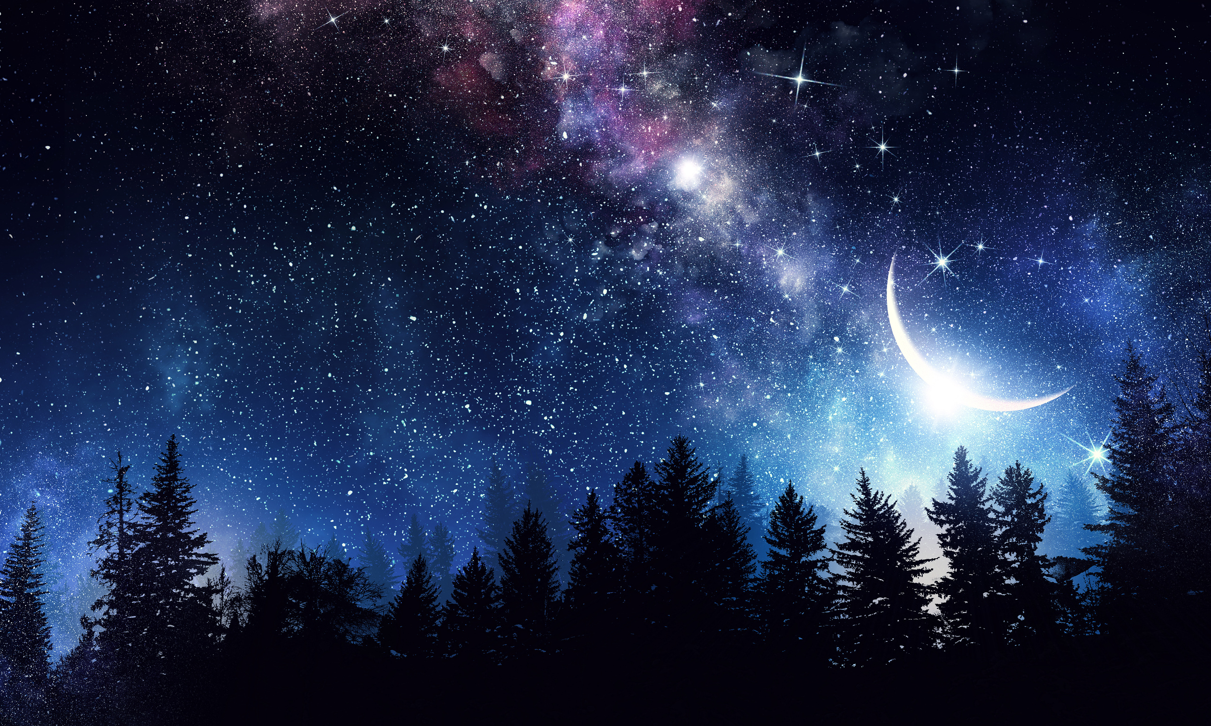
HOW LIGHT POLLUTION AFFECTS THE NIGHT SKY
From this:
the light pollution from the light pillars in our town turns the night sky :

Slide 4
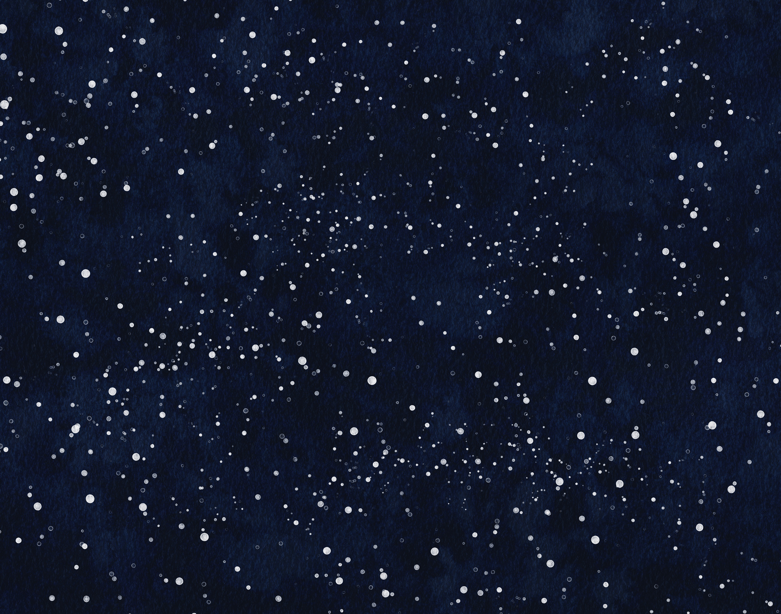

TO THIS:

Slide 5

HERE’S HOW
The Artificial light brightens the night sky, creating a “skyglow” that drowns out fainter stars and celestial objects. In cities, only a handful of the brightest stars are visible, whereas in dark-sky areas, thousands can be seen.

